Slide 1
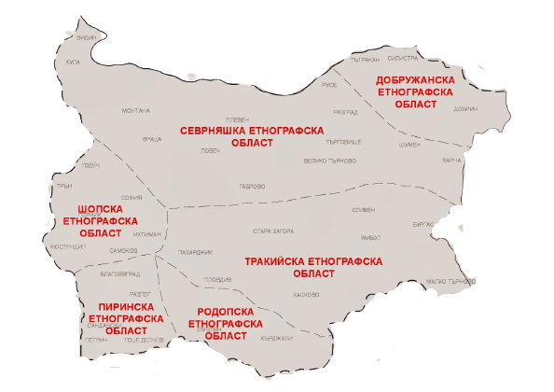
Bulgarian Folklore Areas
Created by RELL

Slide 2
Content
Team
Site description
Scheme of the site
Used technologies

Slide 3
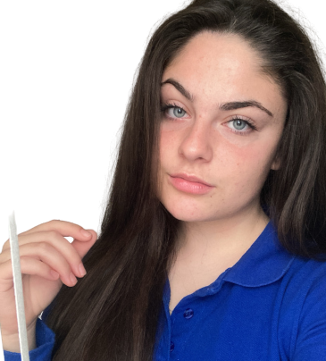
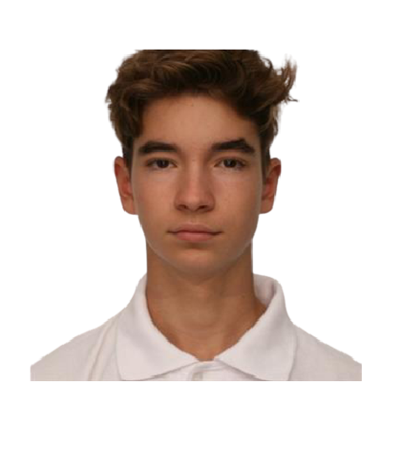
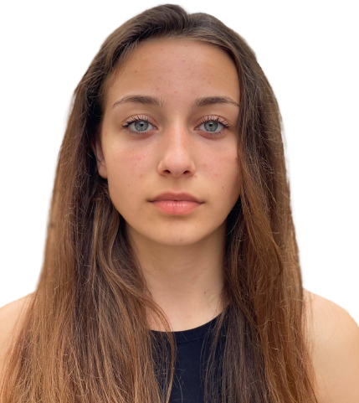
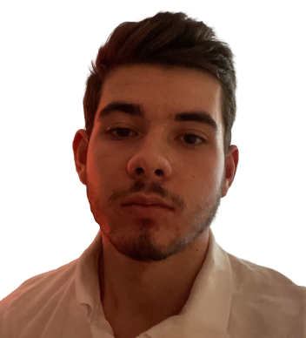
Team
Raya Mavraganova
Eric
Ivanov
Lorena Hristova
Lyubomir
Georgiev
Designer
Back-end
Developer
Front-end
Developer
Scrum Trainer

Slide 4
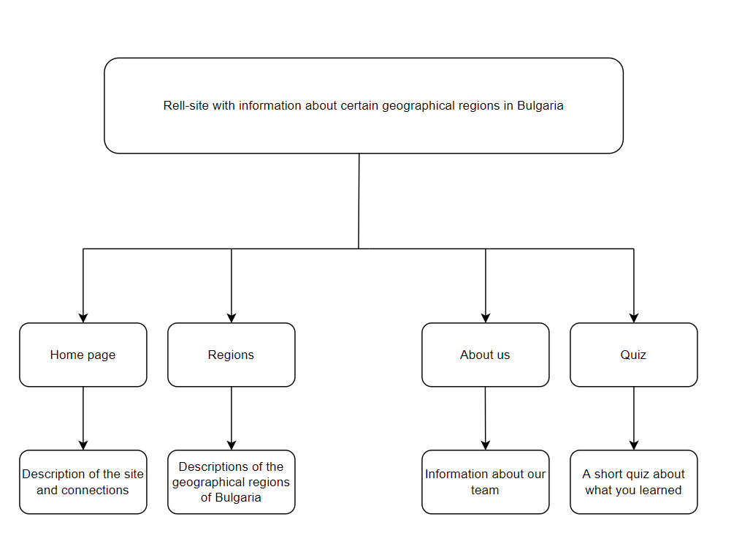
Scheme of the site

Slide 5





Used technologies
Word
Visual Studio code
GitHub
Power Point
Discord

Slide 6
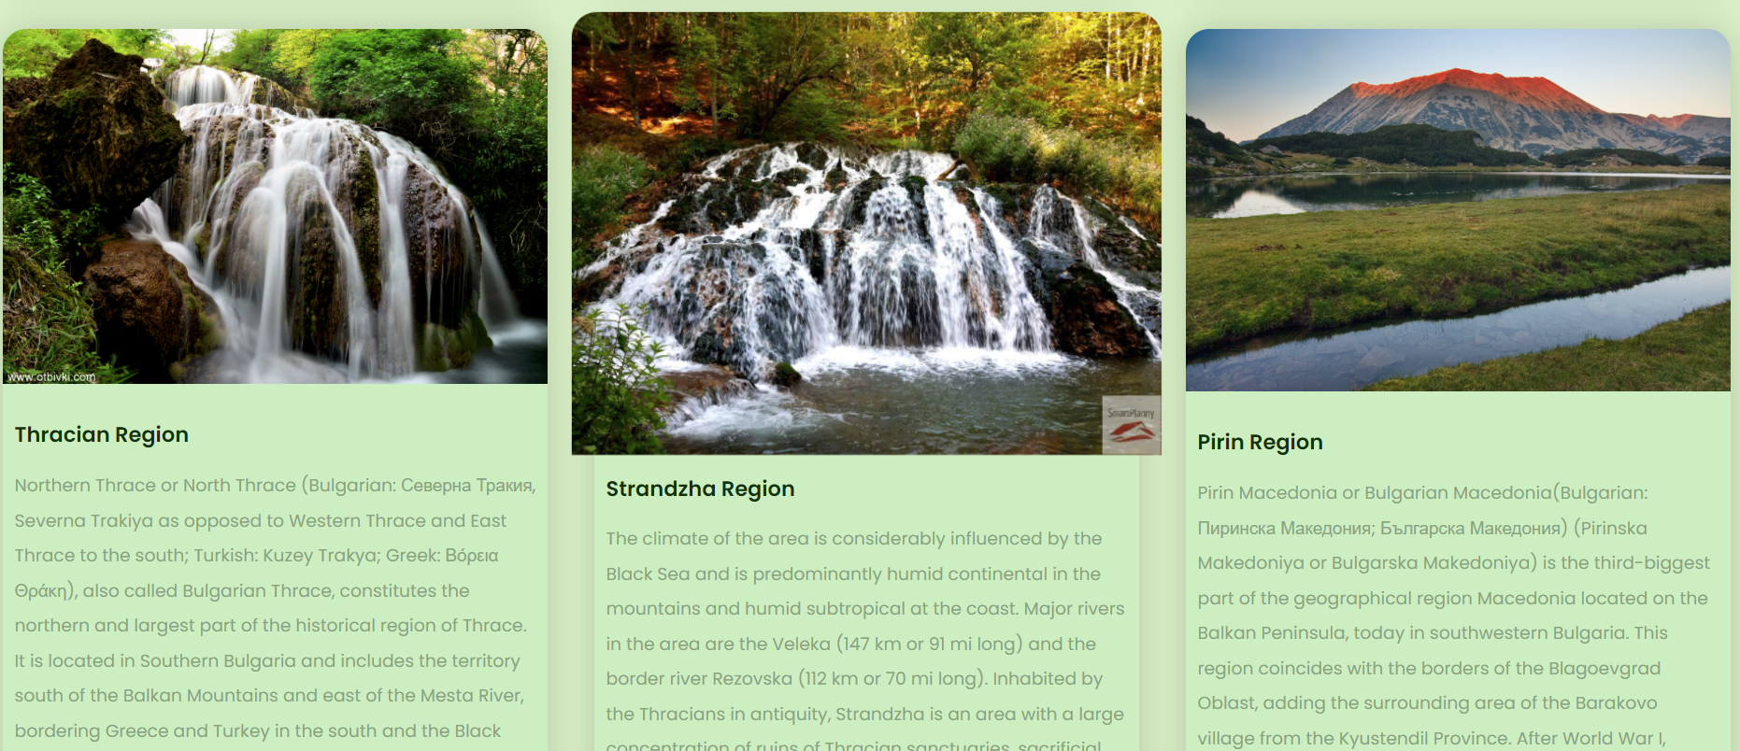
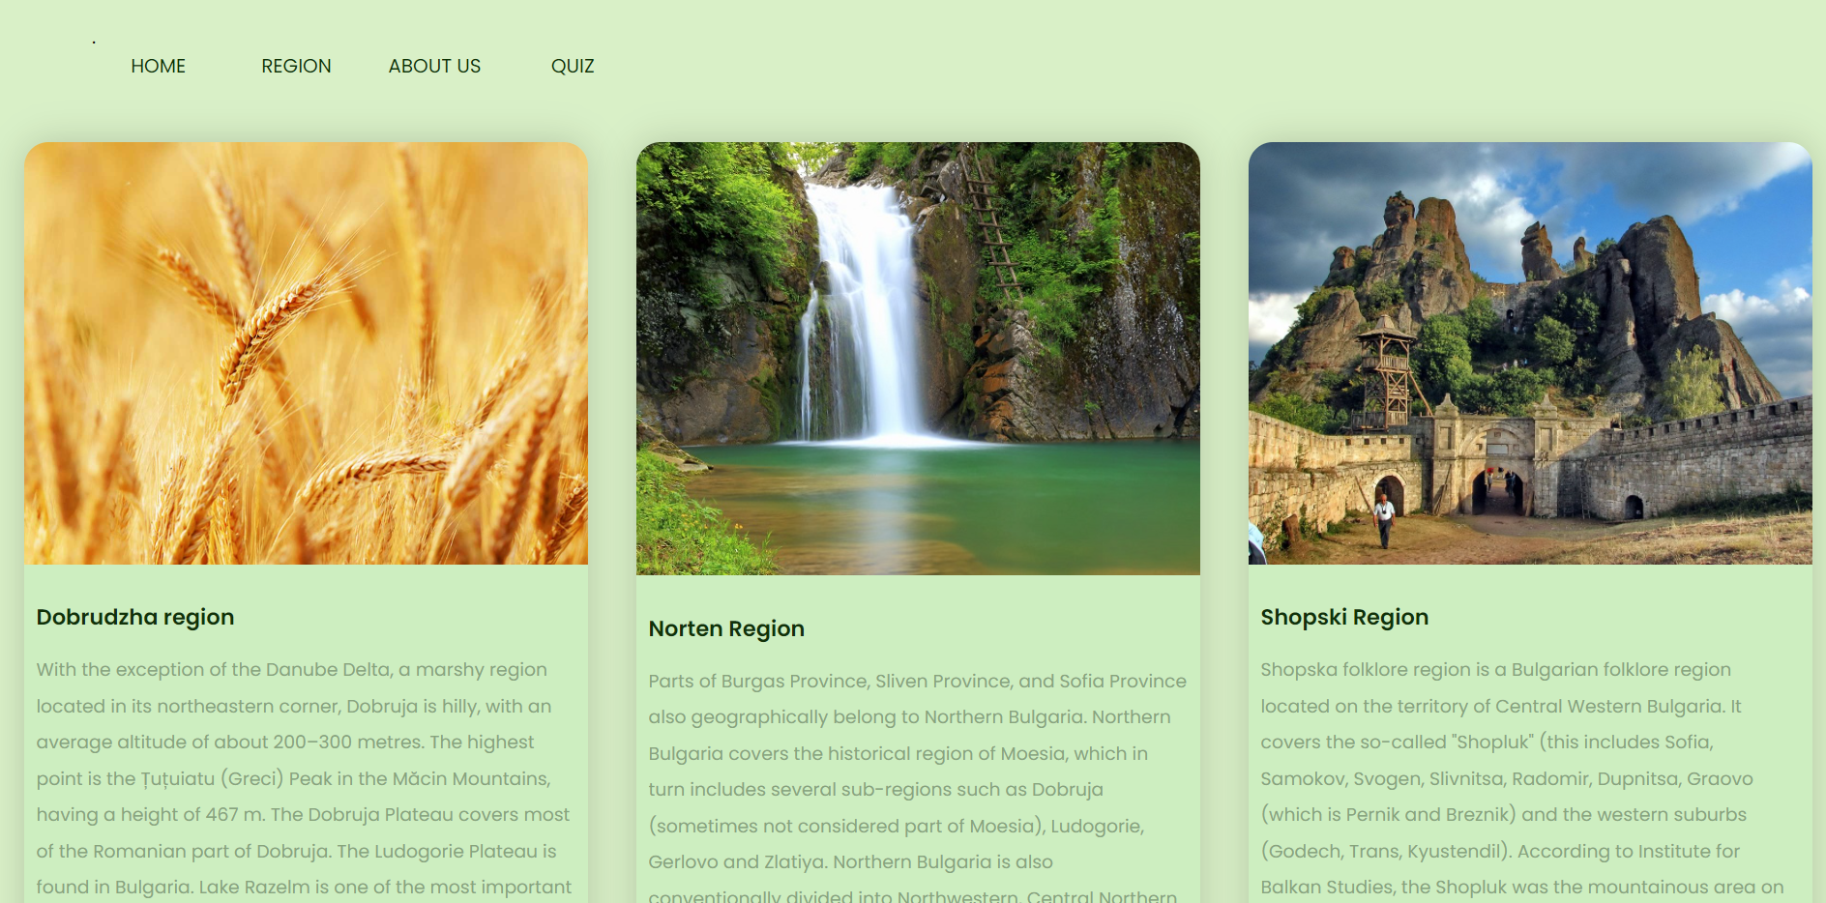
Site description
Our idea is to create a website for historical and geographical information about the Bulgarian folklore areas.

Slide 7

Now, let’s continue to the site!

